Slide 1
Lecture 7: Humans are “Humans”: Understanding and Modeling Humans
Chien-Ju (CJ) Ho

Slide 2
Logistics: Assignment 2
Due: September 30 (Friday)
For majority voting, we mean simple majority voting
EM (only assuming unknown worker skills):
How to choose the weights during the step of weighted majority voting?
The MLE weight log(p/(1-p)) is very sensitive to noise when p approaches 0 or 1
You can do either one of the following:
Crop the probability using ideas in Section 4 of “Who Moderates the Moderators”
Use the (2p-1) weight for workers with correct probability p
technically not leading to MLE, but it give the smallest theoretical error bounds (see lecture 3 and 4)

Slide 3
Logistics: Review and Project Proposal
Review:
Need to elaborate your answers.
I have marked some submissions (with 0.5 gradings or additional comments) that are below the bar.
Project proposal
Due this Friday.
Topics are relatively flexible: as long as your project focuses on “humans” in the computation process
I might suggest/require changes after the proposal
You may check the list of example/past projects

Slide 4
Logistics: Project Timeline
Sep 23: Project proposal
Brief description of the proposed project (1~2 paragraph)
Citing at least one paper that’s relevant to your proposal
Oct 14: Milestone 1
A brief literature review and the description of your plan (one page)
Last chance to change the topic of the project
Nov 4: Milestone 2
Summary of your current progress (up to 2 pages)
Last chance to convert the research project to (a more extensive) literature review
Dec 6/8: In-class project presentations
Dec 9: Project report due

Slide 5
Today’s Lecture

Slide 6
About Assignment 1
Motivated by this post:
My MTurk (half) Workday. Jeff Bigham
How much do you earn per hour?
Side note:
Make sure you read the homework instructions before submitting.
0.04 | 1.20 | 2.00 | 4.40
0.40 | 1.30 | 2.00 | 4.96
0.60 | 1.32 | 2.40 | 5.00
1.00 | 1.50 | 2.64 | 6.00
1.00 | 1.56 | 3.00 | 8.40
1.20 | 1.80 | 3.60 | 12.00
Mean: 2.88
Median: 1.90

Slide 7
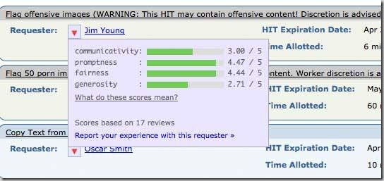
Assistive Tool/Information for Workers
Forums
TurkerNation, MTurkGrind,…
Browser plugins (e.g., Turkopticon)

Slide 8

Crowdsourcing (Requester’s Perspective)
Flower
Dog
Cute
…
“Crowd”
Input
Black Box
Output

Slide 9
The Crowd is Made of People
Flower
Dog
Cute
…

Slide 10
Who are these people?

Slide 11
Why Should We Care?
So we know how to better utilize and interact with the crowd
CS tools let us reason about machine programs (runtime, scalability, correctness, ...)
Need to develop models of human behavior when humans are in the loop
Most studies so far make strong assumptions about human behavior
Remind us crowd workers are humans like us (sounds obvious, but…)
Human-centered research has been receiving great attention
Ethical-related issues (fairness, transparency, and privacy) are important
Relatively under-explored. Potential interesting topics for your projects…
They might be quite challenging though

Slide 12
Who are these workers?
Demographic information
Are workers working independently?
How many workers are there?
…?

Slide 13
The information is not trivial to get
There is no official census data about crowd workers
Potential solutions:
Conducting surveys
Ethnographic analysis of digital trace
What else?
Notes:
This lecture will focus on
the answers to the questions
how to obtain the answers

Slide 14
The (Old) Demographic of MTurk
Survey on 1,000 Turkers
Conduct the survey twice (Dec. 2008 and Oct. 2008)
Consistent statistics
Blog Post:
A Computer Scientist in a Business School https://www.behind-the-enemy-lines.com/
One of the early attempts to understand MTurk demographics

Slide 15
MTurk Worker Demographics (2008): Country
The majority of crowd workers on MTurk come from the US
http://www.behind-the-enemy-lines.com/2008/03/mechanical-turk-demographics.html

Slide 16
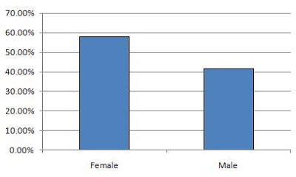
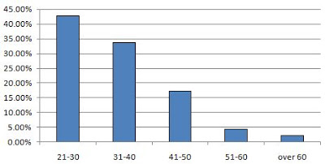
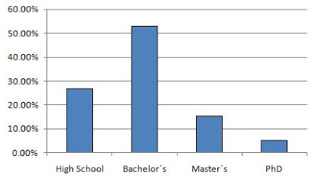
Gender
Age
Education
Income

Slide 17


MTurk Worker Internet Users (2008, US)
Younger
54%
Age: 21-35
22%
More Female
70%
Female
50%
Household
income < 60K
Lower Income
65%
45%
Household
<= 2 people
Smaller Family
45%
28%
http://www.behind-the-enemy-lines.com/2009/03/turker-demographics-vs-internet.html

Slide 18
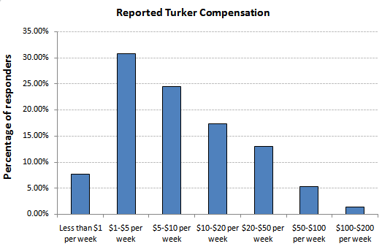
MTurk Worker Demographics (2008): Payment received
http://www.behind-the-enemy-lines.com/2008/09/how-much-turking-pays.html

Slide 19
MTurk Worker Demographics (2008): Purpose

Slide 20
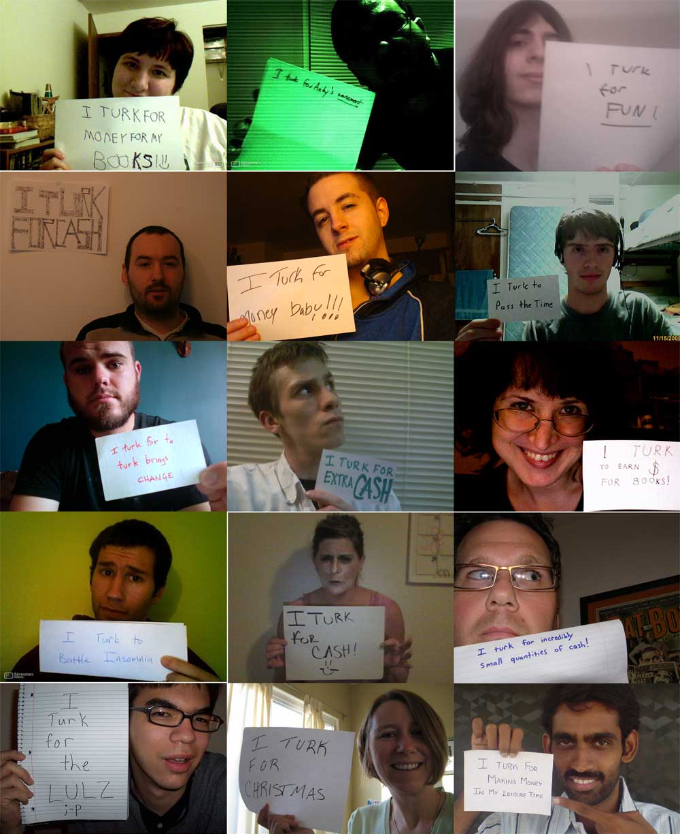
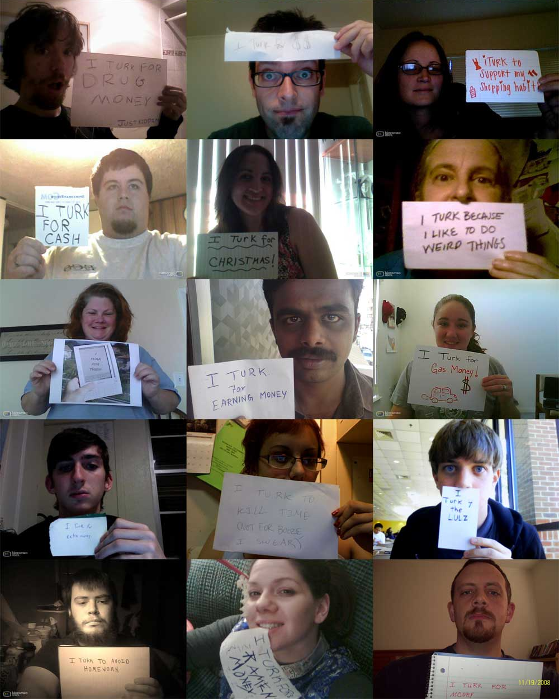
Faces of MTurk Workers
$0.05 => 2 submissions within 24 hours
$0.25 => 8 submissions within 48 hours
$0.50 => 20 submissions within 48 hours
https://waxy.org/2008/11/the_faces_of_mechanical_turk/ (By Andy Baio)
Notes:
I started the task at $.05, but only two people responded in the first 24 hours
I increased it to $.25, receiving eight submissions in 48 hours.
Increasing it to $.50 got me 20 more submissions in about 48
The final results: 30 people total — 10 women, 20 men. Almost all were white, mostly in their 20s and 30s. 21 said they turked for money, 9 for fun or boredom.

Slide 21
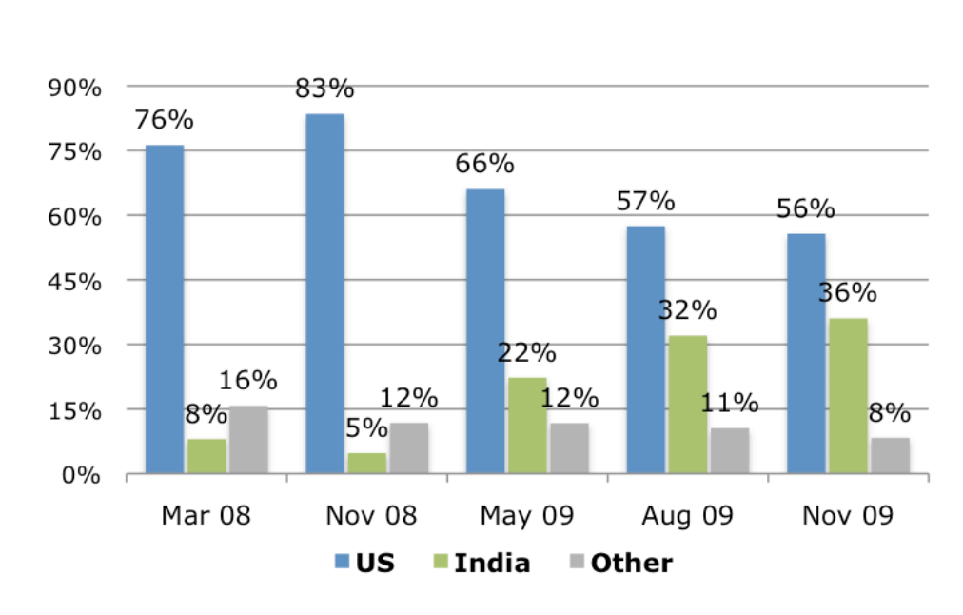
But Demographics Also Changes Over Time…
From a primary US-based workforce to an increasingly international group of workers.
Ross, Joel, et al. "Who are the crowdworkers?: shifting demographics in mechanical turk." CHI’10 EA

Slide 22
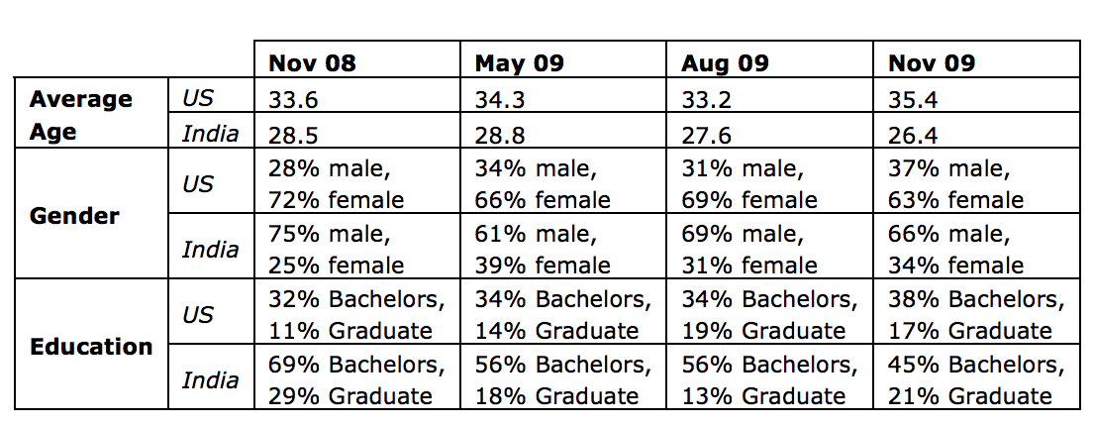
But Demographics Also Changes Over Time…
Ross, Joel, et al. "Who are the crowdworkers?: shifting demographics in mechanical turk." CHI’10 EA

Slide 23
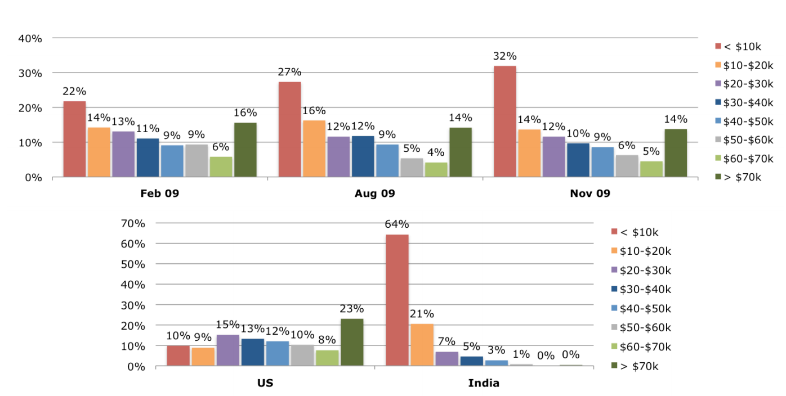
But Demographics Also Changes Over Time…
Ross, Joel, et al. "Who are the crowdworkers?: shifting demographics in mechanical turk." CHI’10 EA

Slide 24
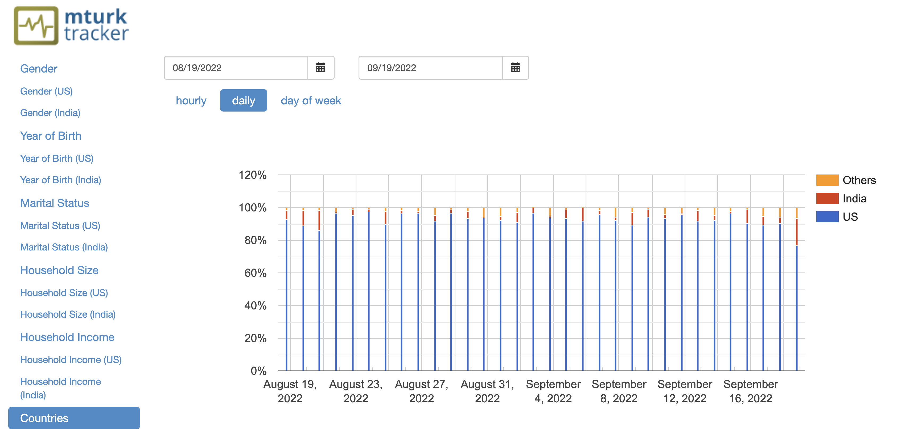
MTurk-Tracker: A Long-Term Demographic Survey
Each worker can take at most one survey in 30 days
https://demographics.mturk-tracker.com/
Notes:
5 cents per survey
: (a) Gender, (b) Year of Birth, (c) Marital Status, (d) Household Size, (e) Household Income, and (f) Location (City, Country)

Slide 25
MTurk-Tracker: A Long-Term Demographic Survey
http://demographics.mturk-tracker.com

Slide 26
Warm-up Discussion
Does the demographic information collected from self-reported survey responses suffer from any problems?
Can you come up with potential fixes for the problems?
What about ethnographic analysis of digital trace in the required reading?
Potential issue 1: Data bias (sampling bias, human bias)
Potential issue 2: Untruthful self-reports

Slide 27
Warm-up Discussion
Does the demographic information collected from self-reported survey responses suffer from any problems?
Can you come up with potential fixes for the problems?
What about ethnographic analysis of digital trace in the required reading?
Potential issue 1: Data bias (sampling bias, human bias)
Potential issue 2: Untruthful self-reports

Slide 28
Sampling Bias
Ideally, we want to select participants from the population “uniformly at random”.
However, it’s not always that easy…

Slide 29
1948 US Presidential Election
Truman vs. Dewey
Chicago Daily Tribune decided to run a phone poll of how people voted

Slide 30
Truman

Slide 31
What Happened?
One explanation: we cannot claim anything for certain.
“The Inescapability of Uncertainty: AI, Uncertainty, and Why You Should Vote No Matter What Predictions Say”. Vaughan and Wallach. 2016.
However, there are bigger issues here…
Phones are expensive in 1948…
Dewey was more favored in rich populations
Imagine you are polling from people in DC/Texas/NY to predict who will win the presidential election…

Slide 32
Sampling Bias
No simple solutions: Be aware of the issue and think about the impact it might bring in your results.
You might be able to “correct” the bias if you have additional knowledge.
Importance sampling
Potentially interesting/relevant paper
Conducting Truthful Surveys, Cheaply. Roth and Schoenebeck. EC 2012.

Slide 33
Are Workers Honest?
Workers are asked to answer demographics questions [Suri et al. 2011]
Sex, Age, Location, Income, Education
Ask workers to privately roll a die and report the outcome.
Payment = $0.25 + $0.25 * roll
If all workers are honest, mean report: 3.5
What do you think the mean was?

Slide 34
Mean: 3.91

Slide 35
Ask Workers to Report 30 Rolls
Not conclusive evidence, but workers are more honest than we think.
However, some workers are not. We should be careful to avoid attacks.
E.g., designing consistency check questions

Slide 36
Methods for Information Collection
Direct surveys
Ethnographic analysis (as in the required reading)
Rely on researchers’ judgements. Not quantitative.
Slowly increasingly, ML has come to help.
More intricate methods
Example 1: How to measure the communication network of the crowd
Example 2: How to measure the size of the crowd

Slide 37
The Communication Network Within the Crowd
Ming Yin , Mary L. Gray , Siddharth Suri , Jennifer Wortman Vaughan. WWW 2016
Acknowledgement: The next few slides are from Ming Yin.

Slide 38
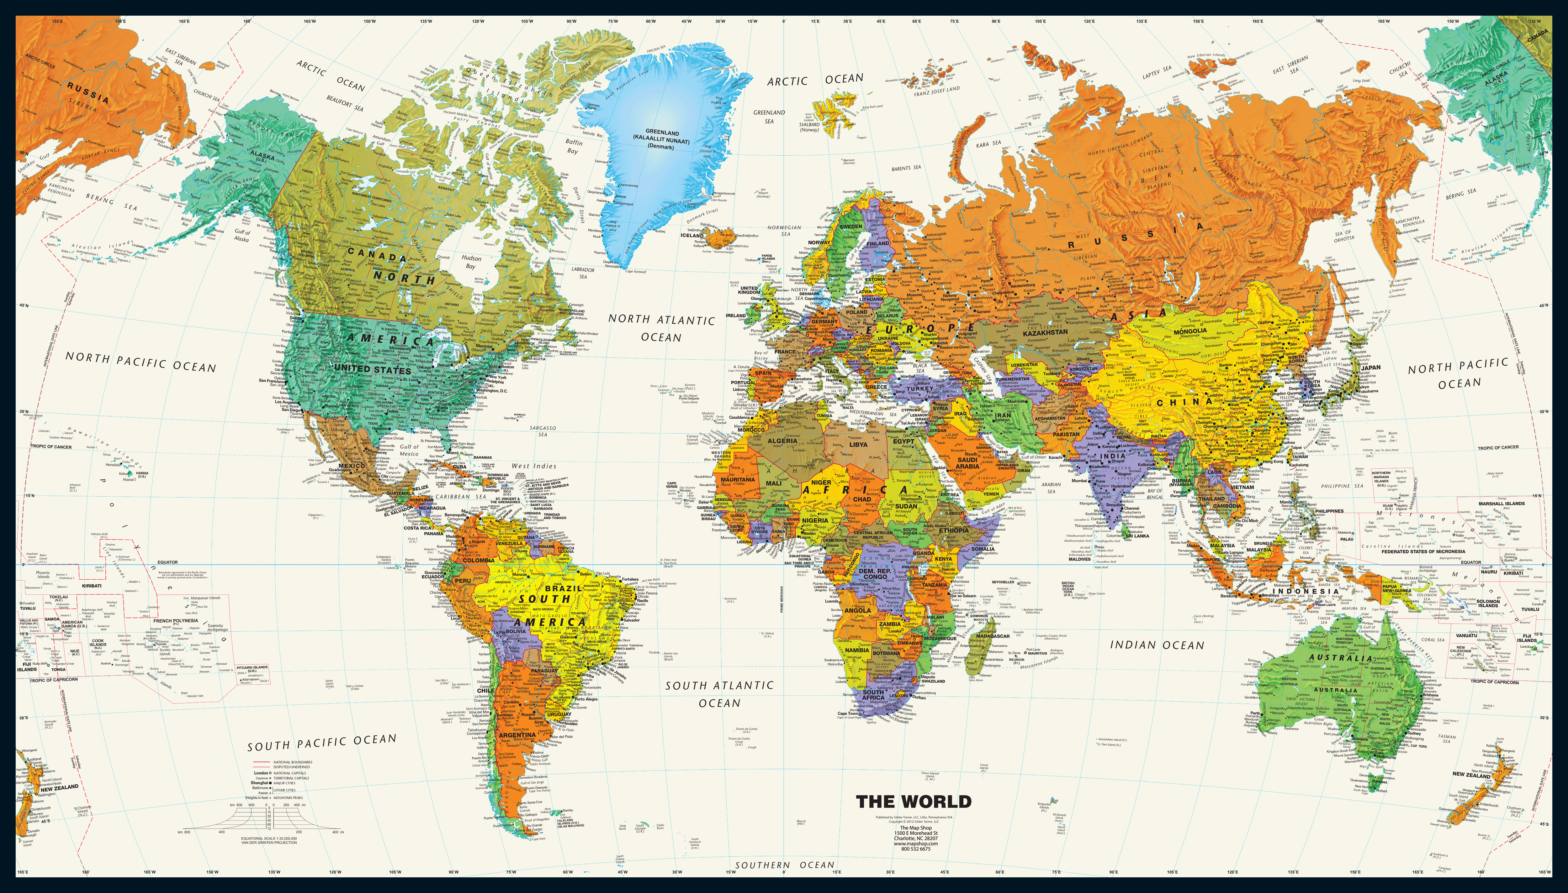






Common Assumption: Workers are Independent
[Yin et al., 2016]

Slide 39
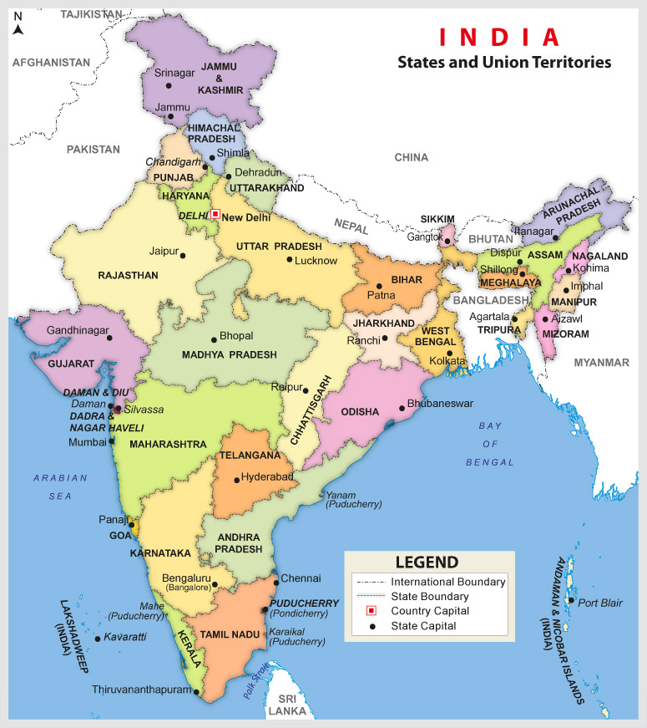

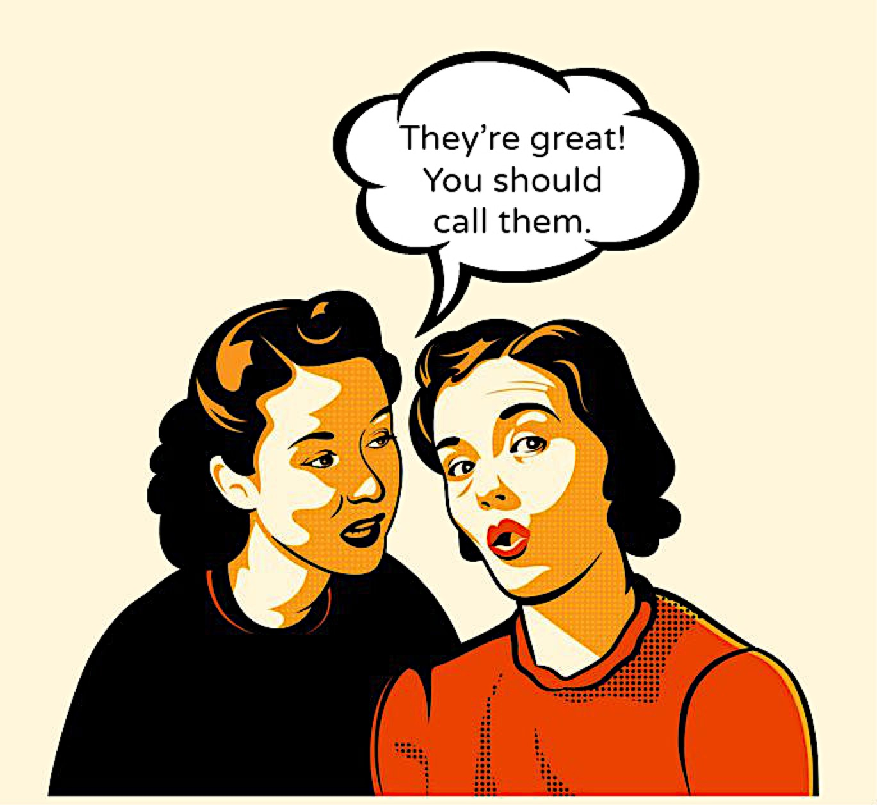


Some Evidence From the Field
Workers talk to each other to...
(based on ~100 interviews)
Help with administrative overhead
Ming’s tasks are great!
Share useful information
Recreate social connections
[Gray, Suri, Ali, Kulkarni. CSCW 2016]
Notes:
So recently a field study conducted in India actually gave a negative answer to this question.
According to about 100 face-to-face interviews with Indian workers, researchers found that on-demand workers in India actually talk to each other so that they can help each other with administrative overhead in doing on-demand work. They also share useful information with each other; and in some cases they will even physically sit in the same space to work together, so they can recreate the social support to each other.
So in other words, all these findings suggest that for the 100 on-demand workers in India who have been interviewed with, they are not just a bunch of independent nodes, there are some edges between these nodes.

Slide 40
Can we Map the Network?
What is the scale?
What is the structure?
How is it used?
[Yin et al., 2016]
Notes:
So now we know edges exist among some workers in India.
But is this a phenomenon that is unique to those 100 Indian workers that researchers have interviewed with, or is this a much more widespread, global phenomenon? Or in other words, can we observe more communication links beyond the 100 Indian workers who have been interviewed?
If the answer is yes, then we may expect there to be a communication network within the crowd. In that case, what kind of topological structure does this network have? And what exactly does this communication network mean for workers?
These questions are certainly beyond the scope of what a field study can answer, so we decide to answer these questions in a different way. In particular, we decide to map this communication network through online experiments, and in this study, we focus on mapping the network among workers of Amazon Mechanical Turk.

Slide 41



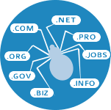
Why is it Challenging?
Not accessible
through API
Not on the
MTurk platform
Nowhere to
download
Can’t just crawl
from the web
The goal…
Elicit “true” connections only
Elicit as many true connections as possible
Preserve workers’ privacy
Can’t pay by connections!
Can’t directly ask for names!
Notes:
But it turns out that mapping the communication network within the crowd is actually a very challenging problem because this network we are talking about is not something that is accessible from the API of the platform. In fact, all the communication takes places completely outside of the MTurk platform. There is nowhere for us to download the data, and we can’t easily crawl the network either. So it seems that we can only collect the data ourselves.
But before we start to do that, we take a step back to think about what we really want here. Essentially we want a way to elicit only the true connections, in the sense that we want workers to tell us whom they actually talk to, and we want to elicit as many of these true connections as possible while preserving workers’ privacy.
So this means that we can’t directly ask workers for names of contact as many social science studies would do, because that can compromise worker’s privacy. In addition, we can’t really use money and pay workers for each connection that they report to us, because that could potentially incentivize workers to report false edges.

Slide 42
A Web App
Workers self-report their connections
Provides some value back to the workers so it’s their best interest to report as many true connections as possible
[Yin et al. 2016]

Slide 43





The Network Mapping App
Step 1: Create a nickname for yourself
Notes:
There are 5 very simple steps in the web application, and I’m gonna to walk you through them now. In the first step, workers are asked to create a nickname for themselves.

Slide 44


The Network Mapping App
Step 2: Complete a brief demographic survey
Age
Gender
Country
Approval rate
…
Share with all other workers
Share with workers connected to me
Not share with anyone
Value back: Who are the other workers?
Notes:
Then, the worker is asked to answer some brief demographic questions like age and gender, and for each question, the worker sets her privacy preference as either she would like to share her answer with all other workers in this web application, or only those workers who are connected to her in the network, or not to share her answer at all.
Later on in the visualization of the communication network, we will show this worker’s profile to other workers according to her privacy setting here. And notice that this is part of the value we provide back to our workers, because these information help workers to get a sense of who their fellow workers are.

Slide 45
The Network Mapping App
Step 3: Tell us about your personal experience with MTurk
Why did you start Turking?
What motivates you to keep Turking?
(Selected based on a pilot study!)
Value back: What are other workers’ Turking stories?
Notes:
In the third step, workers continue to answer two free-form questions, why did they start Turking and what motivates them to keep Turking.
And in fact, these two questions are carefully selected through a pilot study. In the pilot study, we asked workers what are the things that they are most interested in knowing about other workers on MTurk, and these two questions were among the top responses.
Workers are told that their answers to these two questions will be shared to all other workers in our web application. So this is another part of the value we provide back to our workers. We allow our workers to know more about other worker’s stories by exploring the network.

Slide 46

The Network Mapping App
Step 4: Swap nicknames with Turkers you know
Notes:
Now we enter Step 4. In Step 4, workers are asked to take a pause and swap their nicknames with other workers they know, no matter whether those workers have completed our task or not. Workers can swap nicknames by meeting each other in person, through instant messages, phone calls, or essentially in any way that they want.

Slide 47
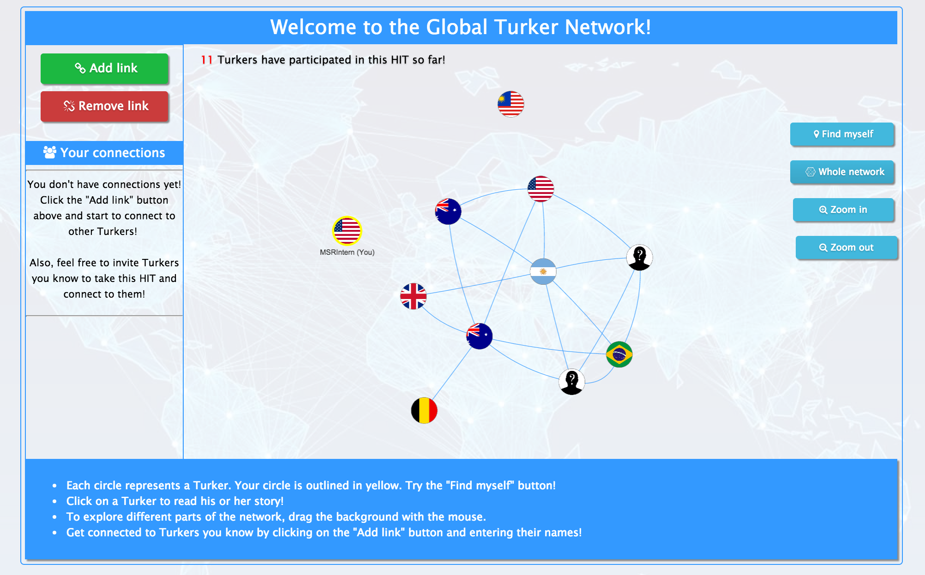
The Network Mapping App
Step 5: Explore the Turker network
Notes:
Finally, the worker will enter the visualization of the communication network and they can start to report their connections to this network.

Slide 48
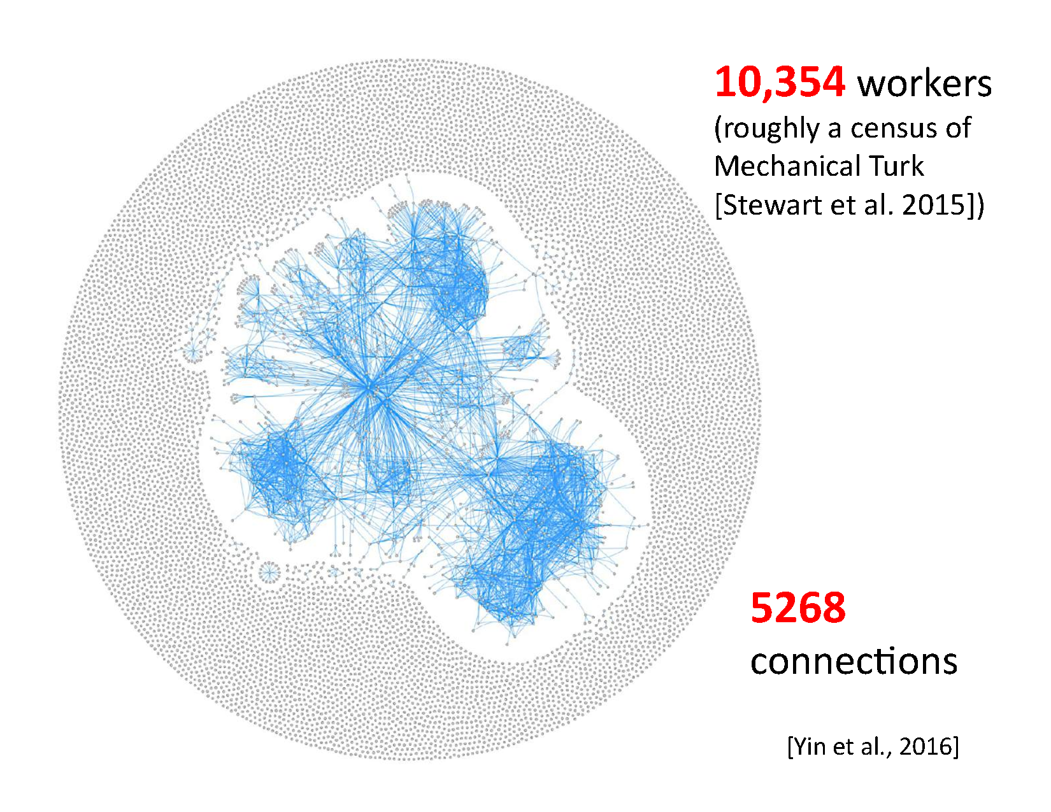
Notes:
After 18 days.

Slide 49
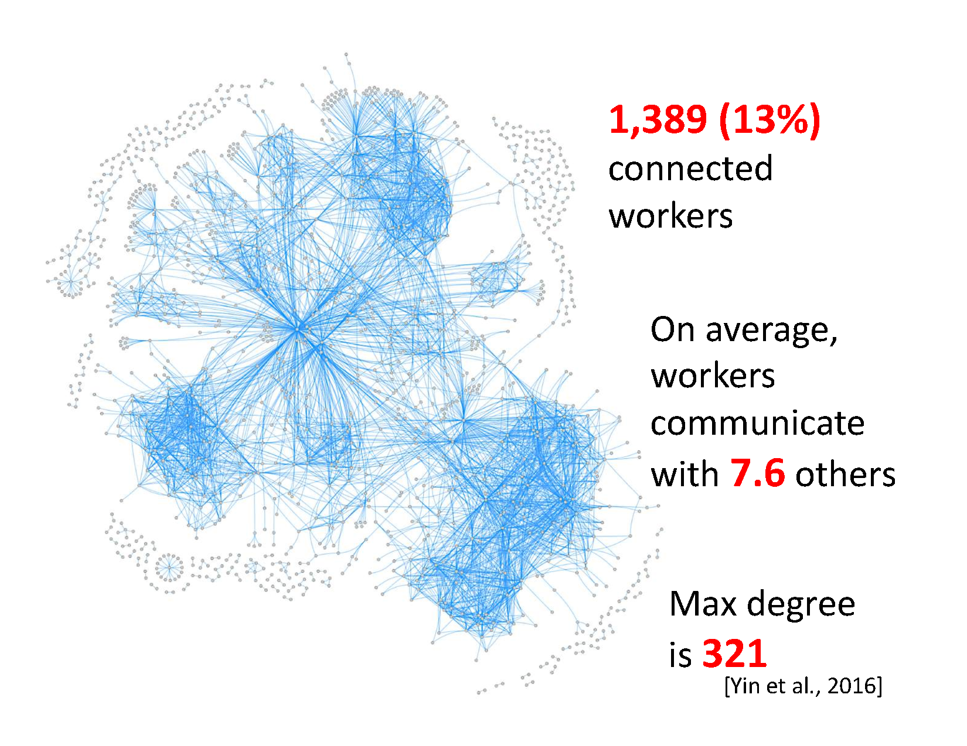

Slide 50
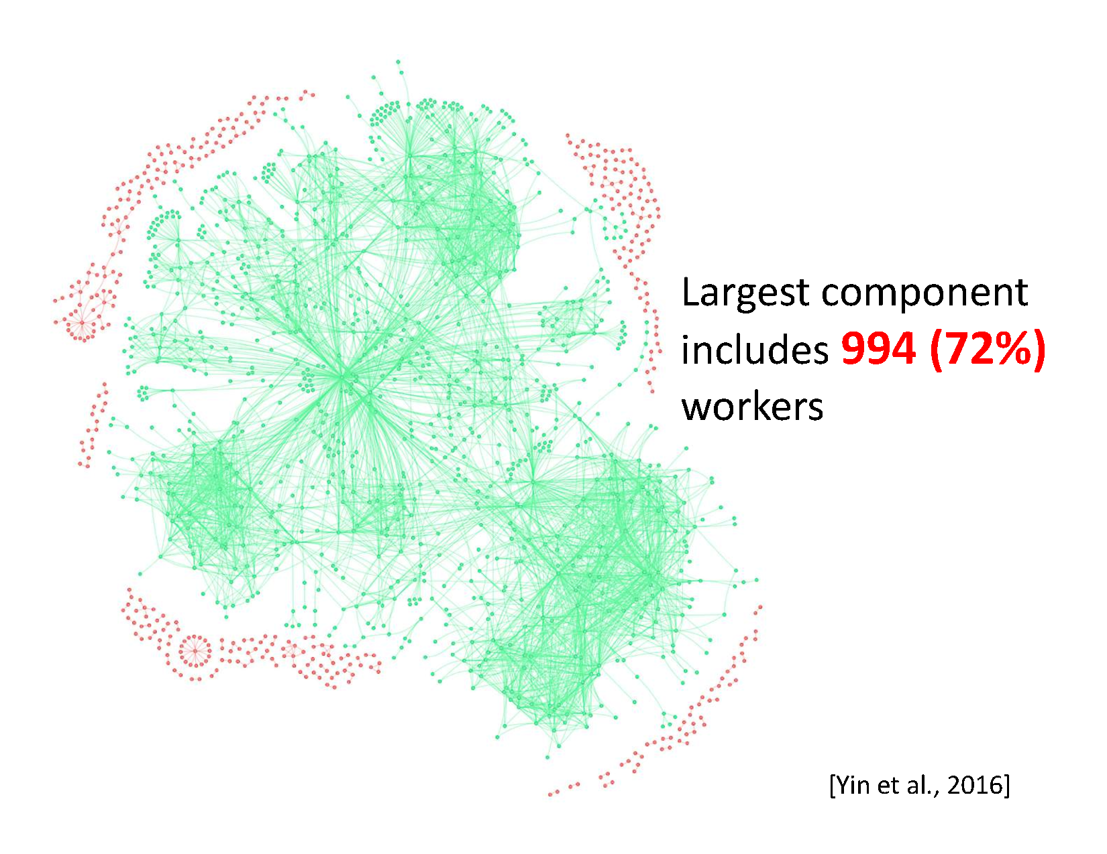

Slide 51
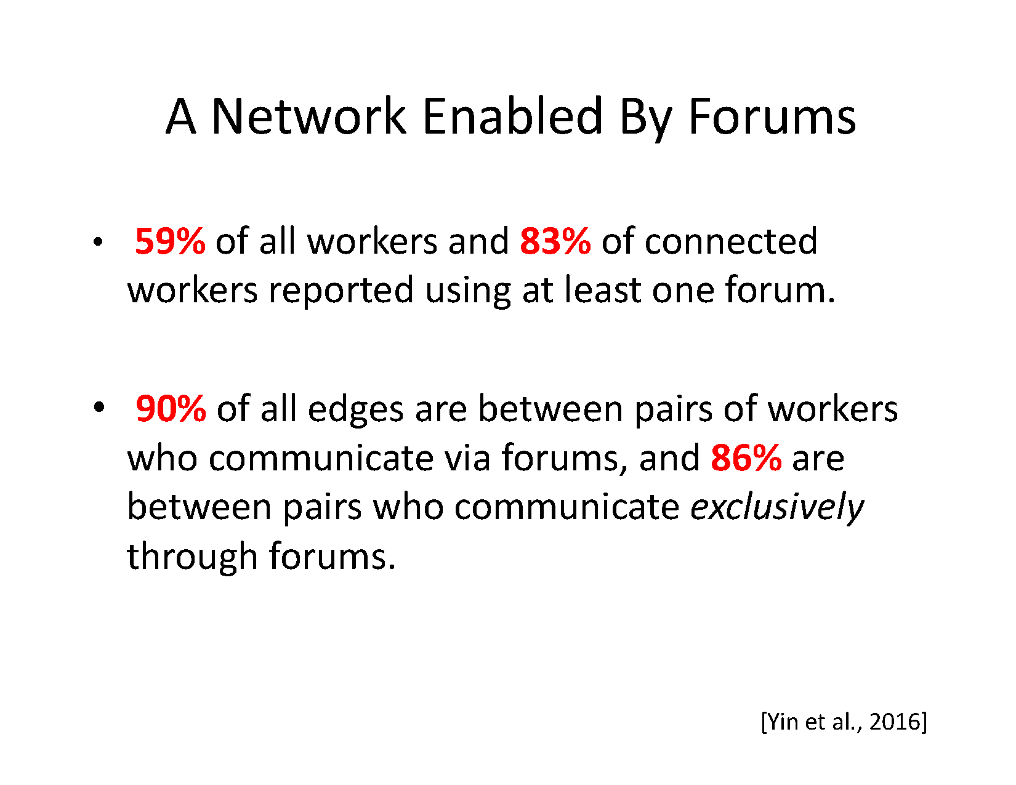

Slide 52
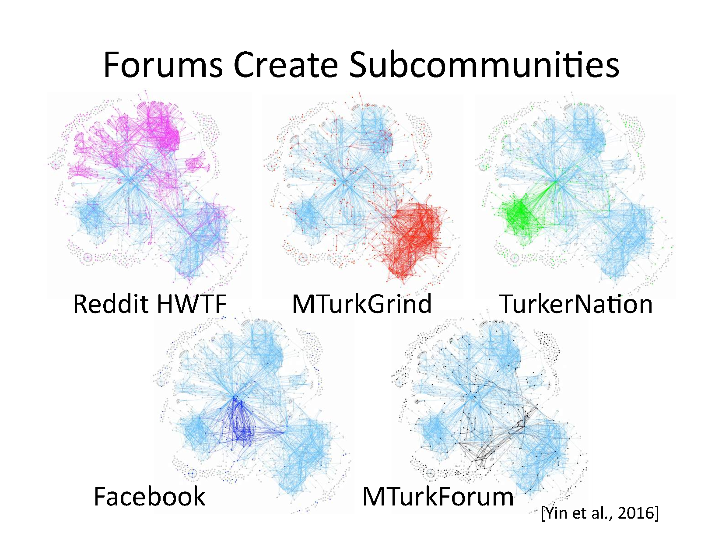

Slide 53
Are workers within communities more “successful”?

Slide 54
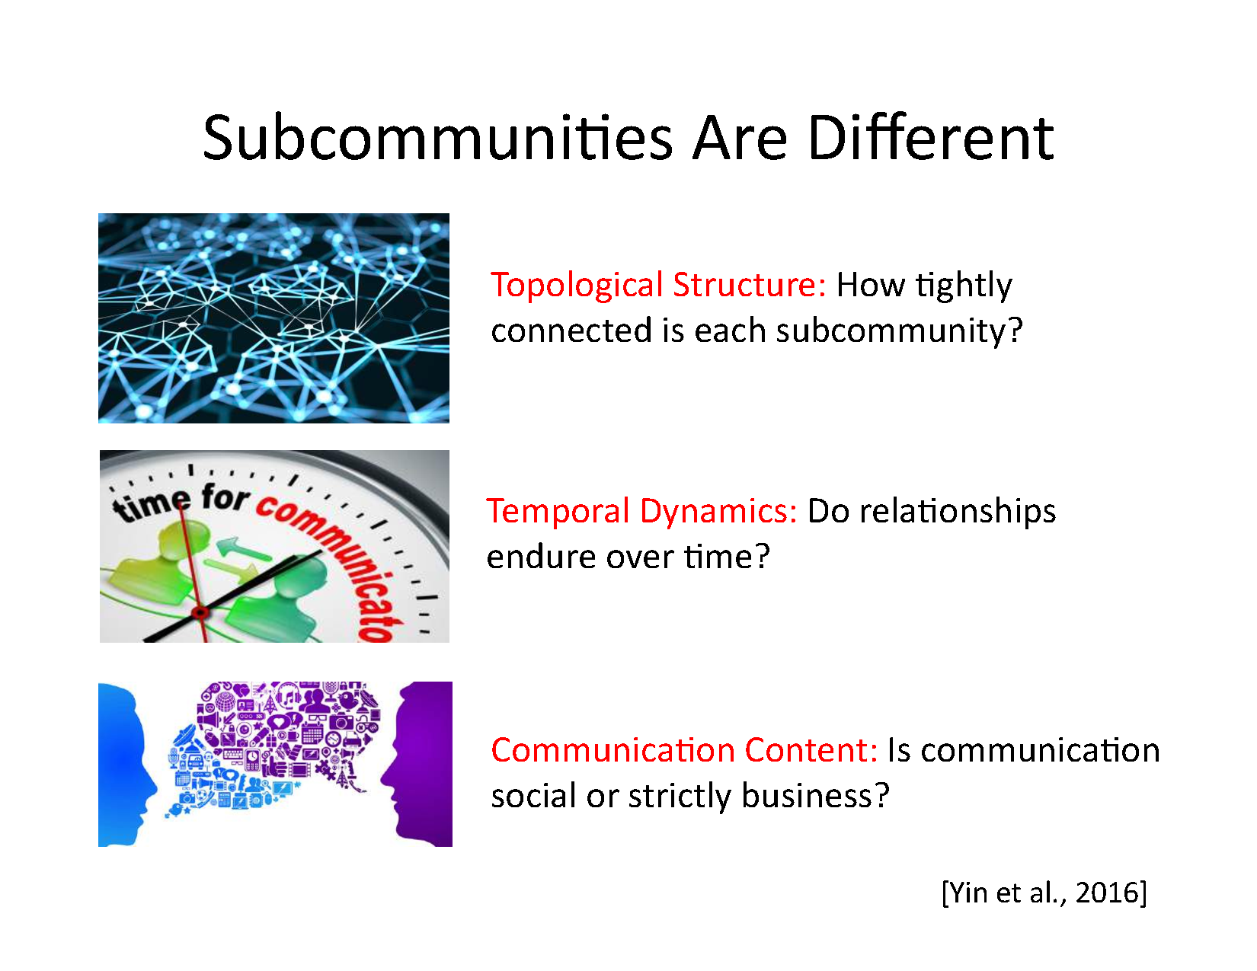

Slide 55
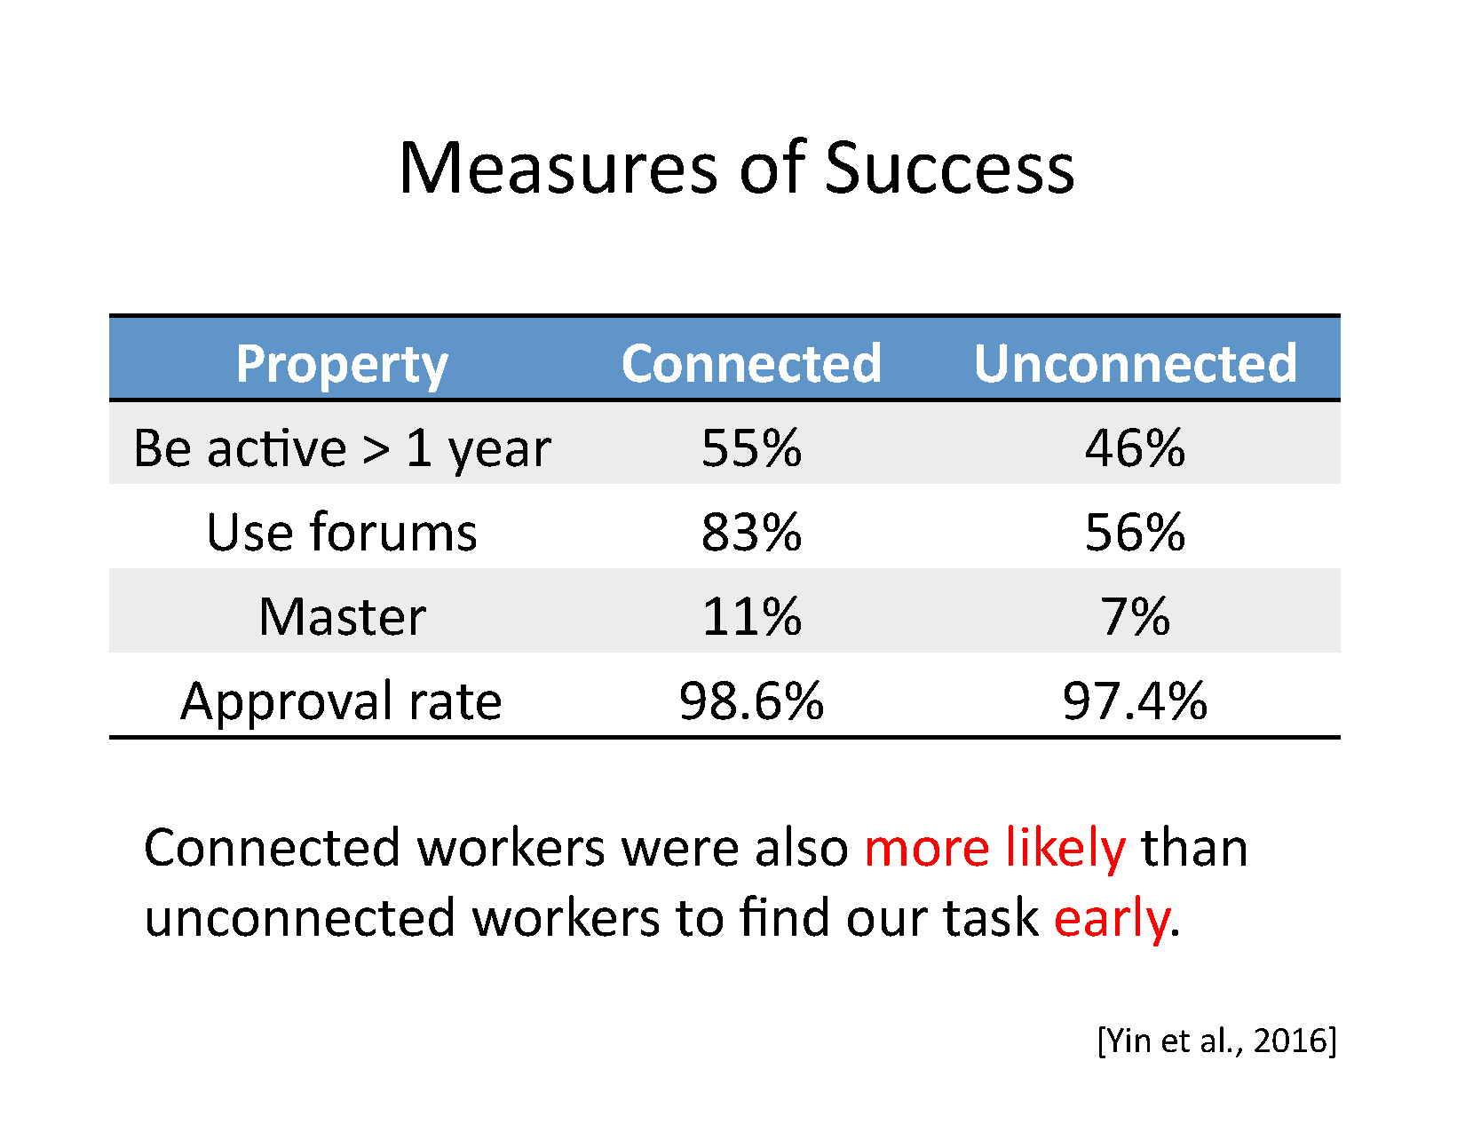

Slide 56
Connected Workers Find HITs Earlier
Notes:
Let me give you some answers to these questions now. So one thing we found is that being connected to other workers may actually imply some informational advantages. What I’m showing to you in this figure is that I sorted all workers who participate in my task according to participation time, and bucket them into groups of 200. Each blue bar in this figure indicates the percentage of connected workers in each bucket of 200 workers.
So basically what you see here is that workers who takes our HITs early are more likely to be connected workers, and workers who takes our HITs late are less likely to be connected,
suggesting that connected workers may have some informational advantage here, so that they can learn about interesting and well-paid tasks earlier than workers who are not connected.

Slide 57
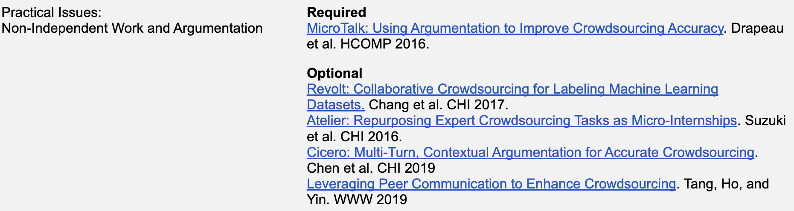
Discussion
What are the implications of this study?
What do you think the fact that there are communication networks would affect the way we think of crowdsourcing?
Notes:
5:25

Slide 58
How Many Workers are There?

Slide 59

How Many Fishes are in the Lake?

Slide 60
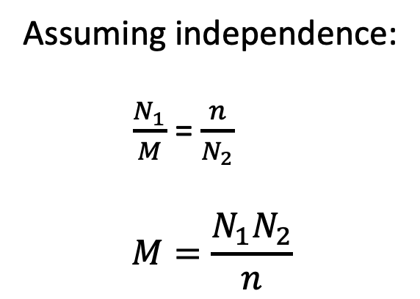
How Many Fishes are in the Lake?
The capture-recapture analysis
Assuming independence:
$\frac{N_{1}}{M}$ = $\frac{n}{N_{2}}$
$$M=\frac{N_{1}N_{2}}{n}$$
M fish, N₁ captured (& marked)
N₂ recaptured, n marked

Slide 61
How Large is the Crowd?
Applying the capture-recapture analysis to workers who respond to demographic surveys, we may estimate that M= 13,410.
What assumptions are made?
A1: Closed population model: No workers will leave the worker pool, and no new workers will join the pool
A2: Equal propensity of participation: The probability to participate in demographic survey is equal across all workers.
Difallah et al. "Demographics and Dynamics of Mechanical Turk Workers”, WSDM’18

Slide 62
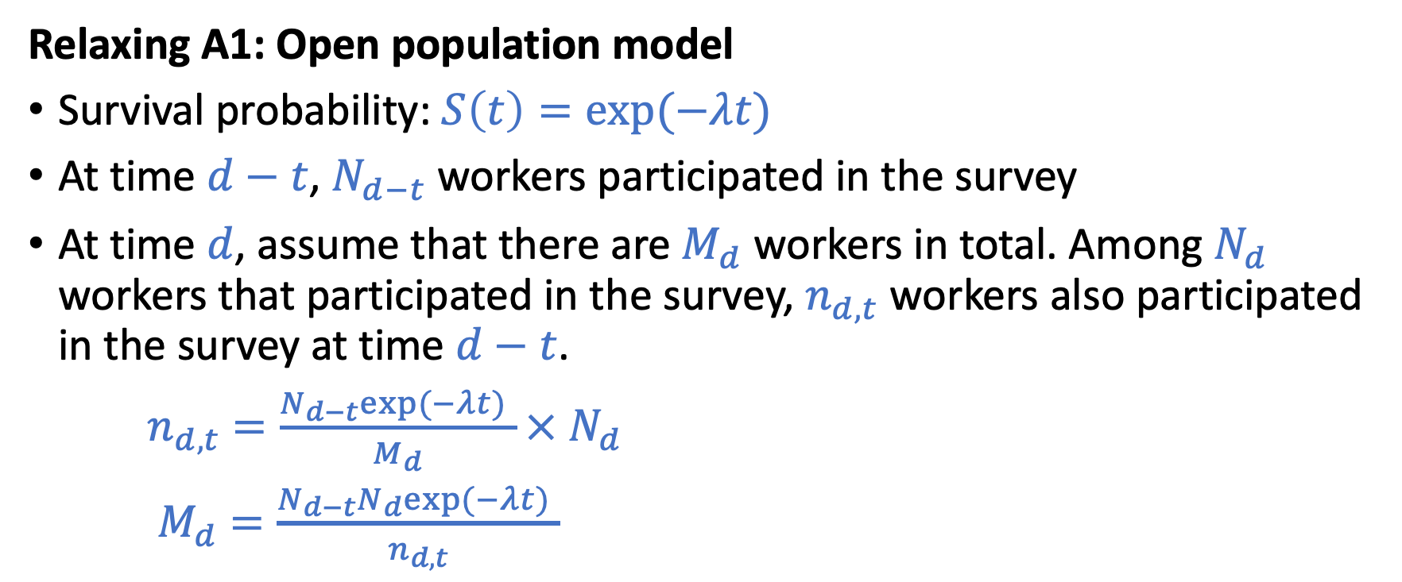
How Large is the Crowd?
Relaxing A1: Open population model
Survival probability: $S\left(t\right)=exp⁡(−λt)$
At time $d−t$, $N_{d−t}$ workers participated in the survey
At time $d$, assume that there are $M_{d}$ workers in total. Among $N_{d}$ workers that participated in the survey, $n_{d, t}$ workers also participated in the survey at time $d−t$.
$n_{d, t}$ $=\frac{N_{d−t}exp⁡(−λt) }{M_{d}}×$ $N_{d}$
$M_{d}$ $=\frac{N_{d−t}N_{d}exp⁡(−λt) }{n_{d, t}}$
Difallah et al. "Demographics and Dynamics of Mechanical Turk Workers”, WSDM’18

Slide 63
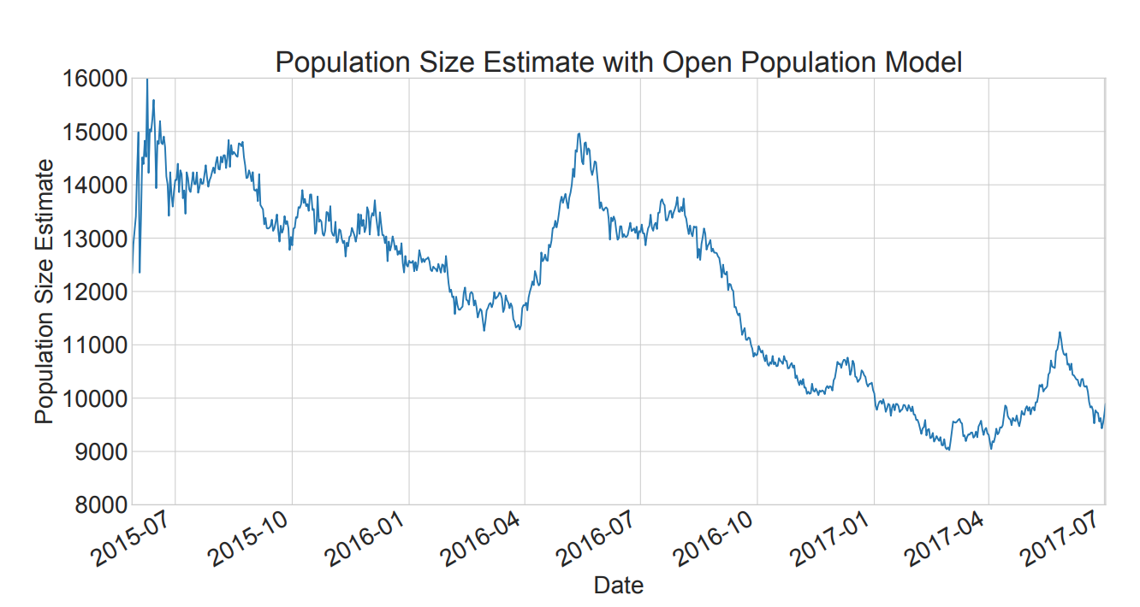
How Large is the Crowd?
Half-life of the MTurk worker population is 404 days
Difallah et al. "Demographics and Dynamics of Mechanical Turk Workers”, WSDM’18

Slide 64
How Large is the Crowd?
Is “A2: Equal propensity of participation” reasonable?
If every worker participate the survey with the same probability, we should see a binomial distribution over # participations with many surveys.

Slide 65
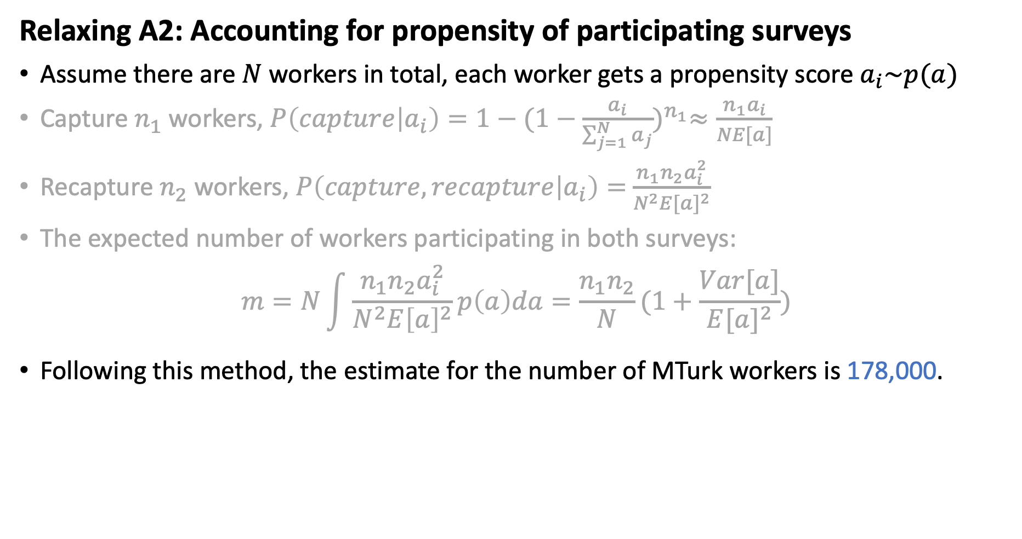
How Large is the Crowd?
Relaxing A2: Accounting for propensity of participating surveys
Assume there are $N$ workers in total, each worker gets a propensity score $a_{i}\sim p(a)$
Capture $n_{1}$ workers, $P\left(capture | a_{i}\right)=1−{(1−\frac{a_{i}}{\sum_{j=1}^{N}{a_{j}}})}^{n_{1}}≈\frac{n_{1}a_{i}}{NE[a]}$
Recapture $n_{2}$ workers, $P\left(capture, recapture | a_{i}\right)=$ $\frac{n_{1}n_{2}a_{i}^{2}}{N^{2}{E[a]}^{2}}$
The expected number of workers participating in both surveys:
$$m=N\int{\frac{n_{1}n_{2}a_{i}^{2}}{N^{2}{E\left[a\right]}^{2}}p\left(a\right)da=\frac{n_{1}n_{2}}{N}}(1+\frac{Var[a]}{{E[a]}^{2}})$$
Following this method, the estimate for the number of MTurk workers is 178,000.
Difallah et al. "Demographics and Dynamics of Mechanical Turk Workers”, WSDM’18
Notes:
5:00

Slide 66
Data-Driven Approaches
Want to collect some information.
It’s challenging to obtain enough data points to estimate the information.
Propose models (i.e., making assumptions) of the process. So you only need to estimate a small number of model parameters.
Using ML approaches to learn those parameters from data.
Your estimate is only as accurate as the best your model can do.

Slide 67
Discussion
What additional information do you want to know about Turkers?
Can you come up with methods to collect that information?
Does that information help us design better crowdsourcing platforms? How?

